Slide 1
February 14th, 2019
Project 2
Matt Beneventi / Javier Benitez / Tahseen Chisti / Emily Coffield

Slide 2

Abstract
How does crime in NYC correlate with lower/higher standards of living as it relates to housing code violations? Higher crime area suggest a lack of desirability in location and has greater potential of corrupt landlords and decrepit living situations. We are curious to visualize the correlation.

Slide 3
The Data

Slide 4

What: The Brand and Offering
Housing Maintenance Code Violations
Pursuant to New York City’s Housing Maintenance Code, the Department of Housing Preservation and Development (HPD) issues violations against conditions in rental dwelling units that have been verified to violate the New York City using Maintenance Code (HMC) or the New York State Multiple Dwelling Law (MDL). Violations are issued when an inspection verifies that a violation of the HMC or MDL exists. It is closed when the violation is corrected, as observed/verified by HPD or as certified by the landlord.
NYPD Complaint Data Historic
This dataset includes all valid felony, misdemeanor, and violation crimes reported to the New York City Police Department (NYPD) from 2006 to the end of last year (2017). For additional details, please see the attached data dictionary in the ‘About’ section.
NYC Median Home Values
Median Household Income for 2010 Census Tracts in the RPA region including estimated breakdowns for transportation costs, housing costs, and income taxes. Last Updated: January 5, 2015,

Slide 5

What: The Brand and Offering
Data Munging
We downloaded CSV data from NYC OpenData. We were able to do data filtering on dates within the website prior to download. Initially we tried using the Flask app to convert the CSV into an SQLite and MySQL but we found the write process would have taken 23 days with the 2 million lines of data found in 4 years of crime data. We then found an app that would convert the CSV data into SQLite.
Median Home Price API: http://data.beta.nyc//dataset/d6ffa9a4-c598-4b18-8caf-14abde6a5755/resource/74cdcc33-512f-439c-a43e-c09588c4b391/download/60dbe69bcd3640d5bedde86d69ba7666geojsonmedianhouseholdincomecensustract.geojson
Housing Code Violations API: https://data.cityofnewyork.us/resource/b2iz-pps8.json

Slide 6
Flask

Slide 7


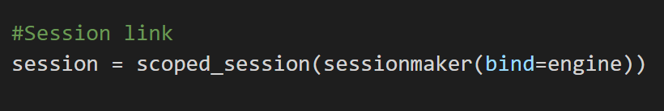
Flask Application
Restful API
Creating the Flask server proved to be one of the more challenging aspects of this project.
A problem we frequently came across was the server only allowed access to the data once.
To rectify this we used a scoped_session from the SQLAlchemy library. This allowed us to call the data multiple times.

Slide 8
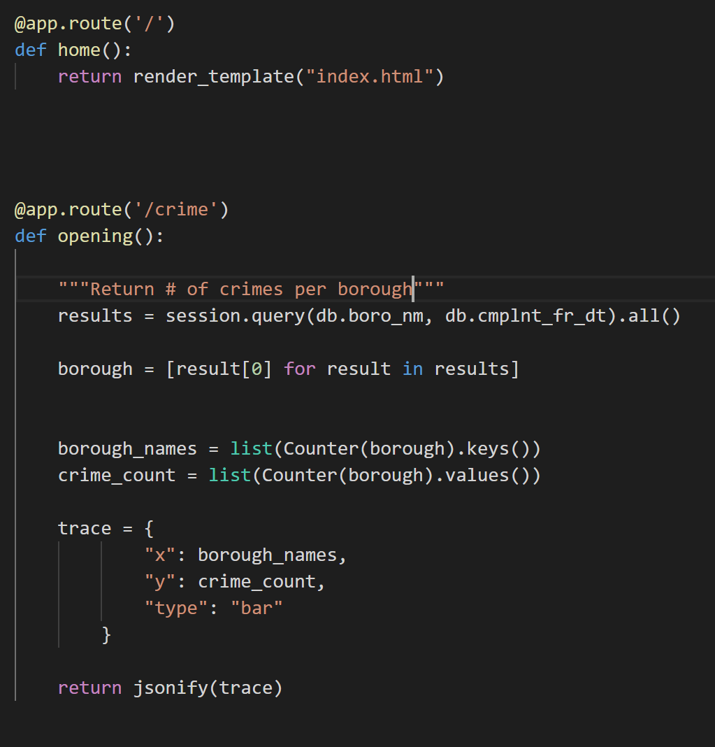
Flask Server Code

Slide 9
Javascript

Slide 10
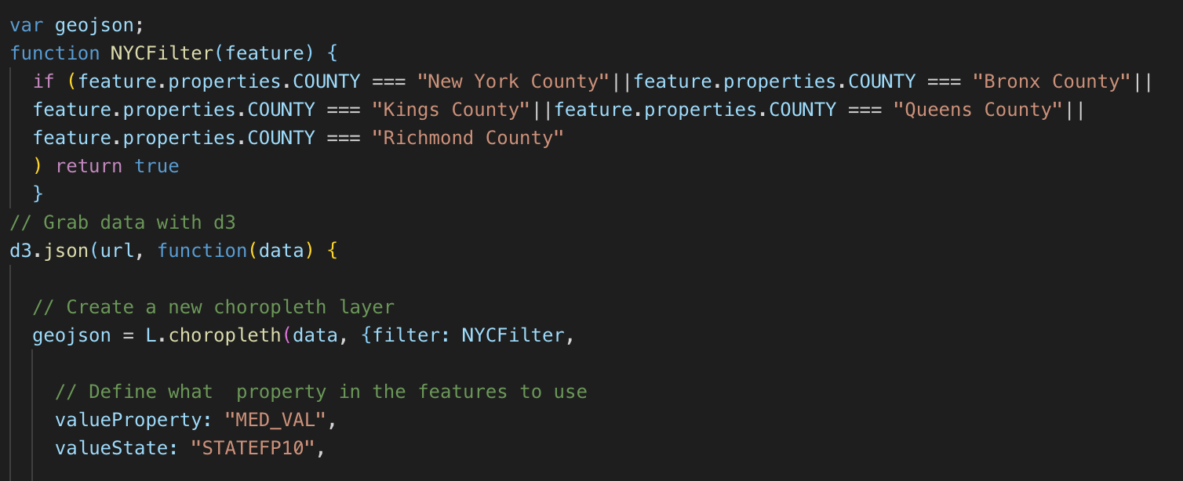
JavaScript
The Median Home Values were extracted from the GeoJSON from http://data.beta.nyc/dataset/median-household-income-2010-census-tracts
We were able to isolate New York City by filtering at the state and county level. The “MED_VAL” property allowed us to represent the Median Home Value. (GEOJSON, D3 and Choropleth implemented)

Slide 11
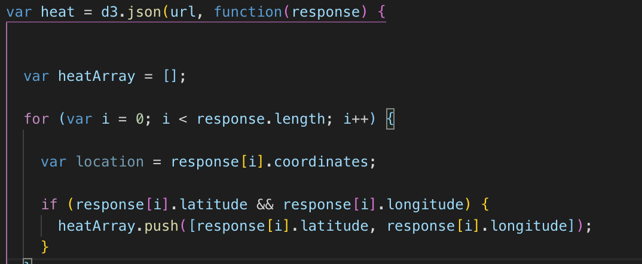
JavaScript
The heatmap was created from:
https://data.cityofnewyork.us/resource/b2iz-pps8.json
A for loop was used to scrape through the longitude and latitude coordinates to represent the responses for Housing Code Violations. A heatmap was implemented to show the higher concentration areas within New York City. (Leaflet, D3 used)

Slide 12
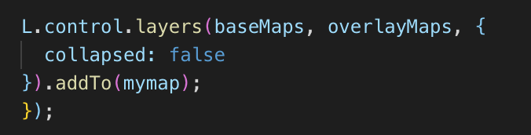
JavaScript
We combined the Median Home Value and Heatmap HTML pages for visual representation. We used an overlay function for user control.

Slide 13
HTML/CSS

Slide 14
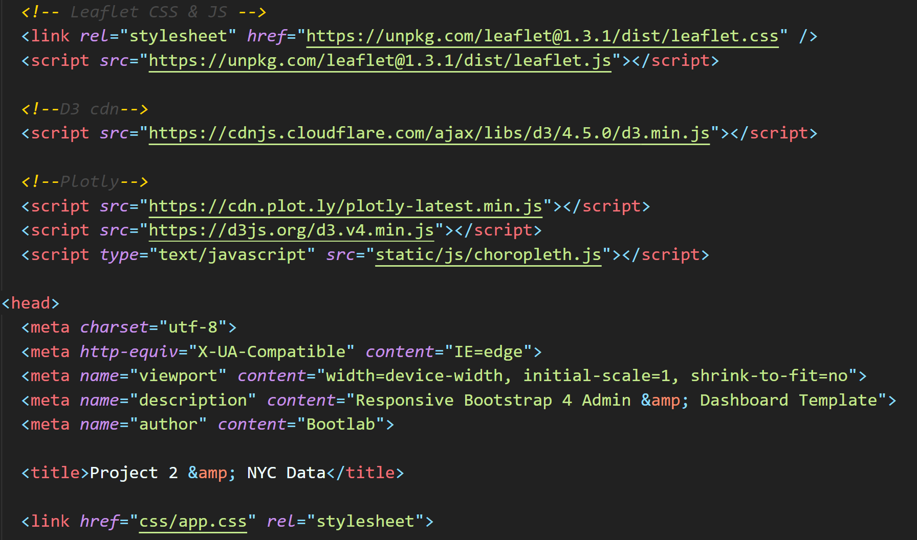
HTML/CSS
HTML templates guided us on creating a visually appealing display, however we found that templates tended to be somewhat advanced and became opaque very quickly. We realized one of our issues around getting the data to flow through properly was that we needed to link our data in several places within the template to get it to work, which was trial and error. Once we accomplished this completing the rest was mostly a process of code elimination. We found that although the templates provided a foundation for the visual aspects, we still had to have an understanding of how the template worked so we could get our data to appear properly.
The code itself was broken out into sections for Leaflet/JavaScript, D3, maps, charts, and data visualizations.

Slide 15
Visualizations

Slide 16

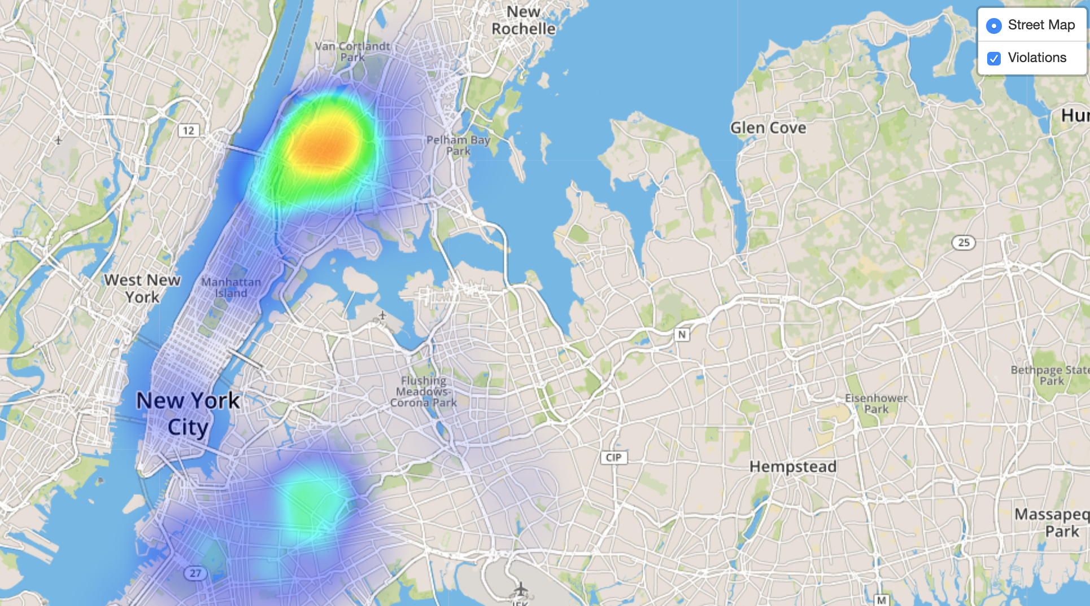
Visualizations
Heat Map

Slide 17
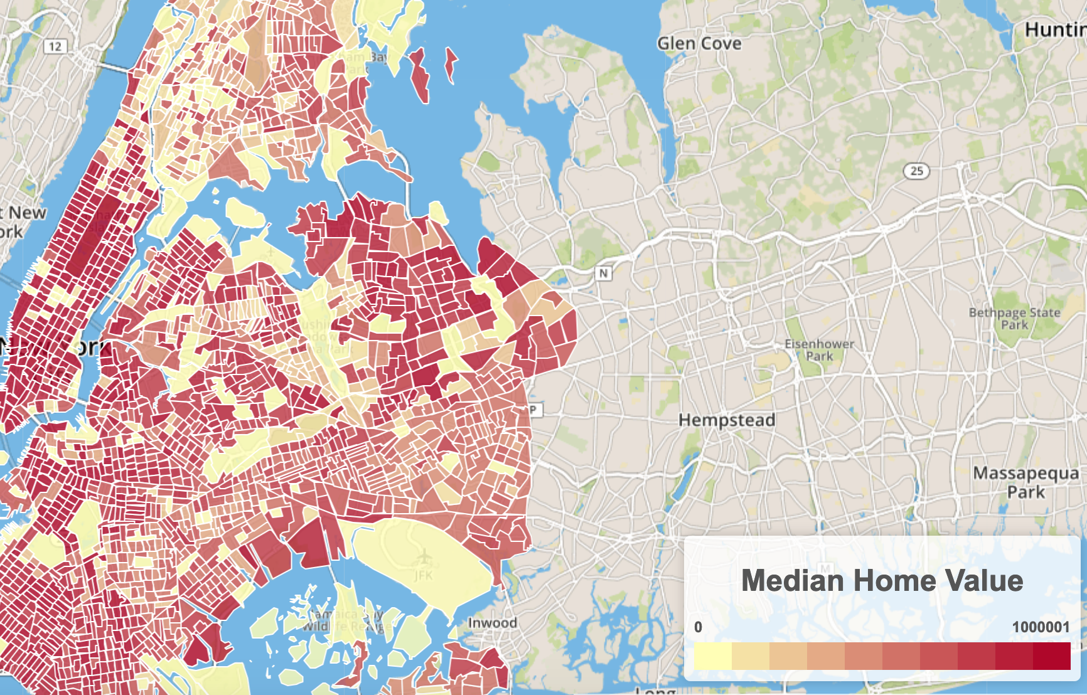
Visualizations
Median Home Value

Slide 18
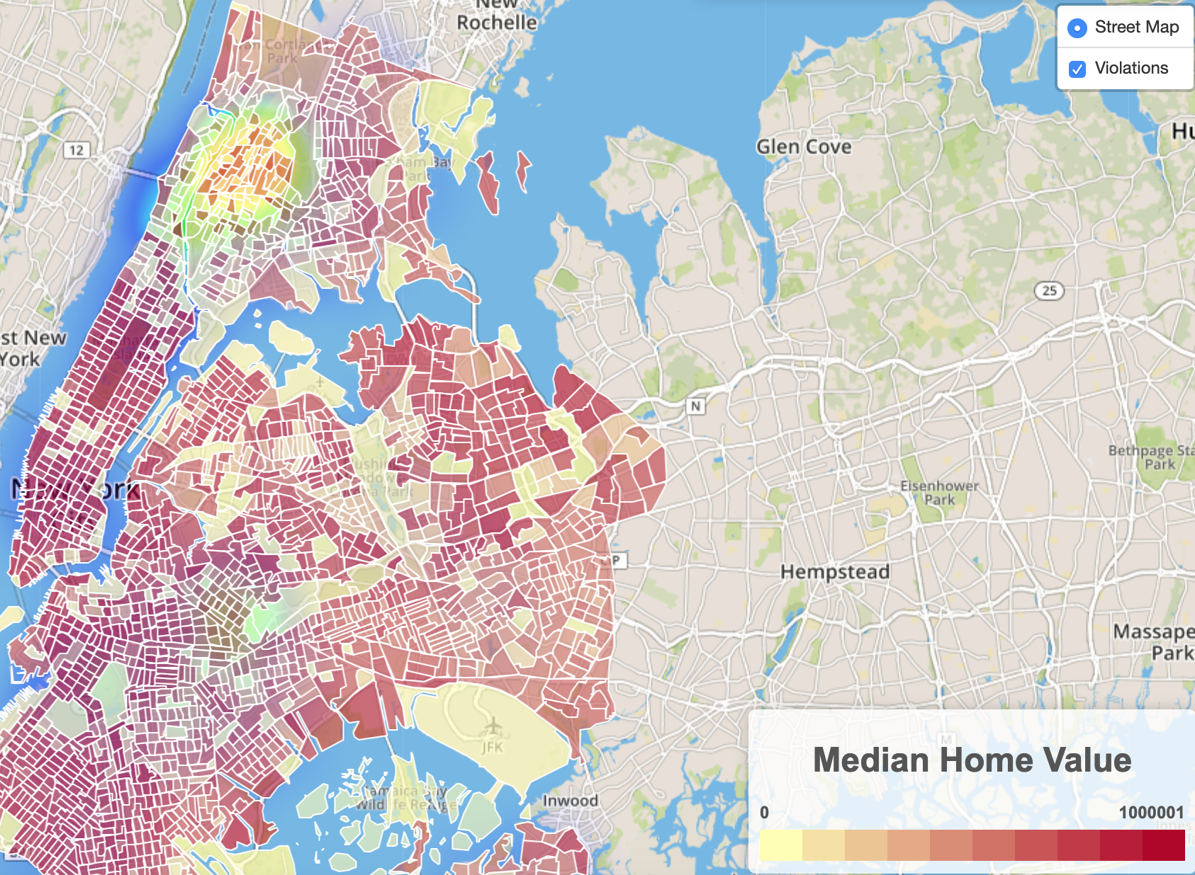
Visualizations
Combined Interactive Map

Slide 19
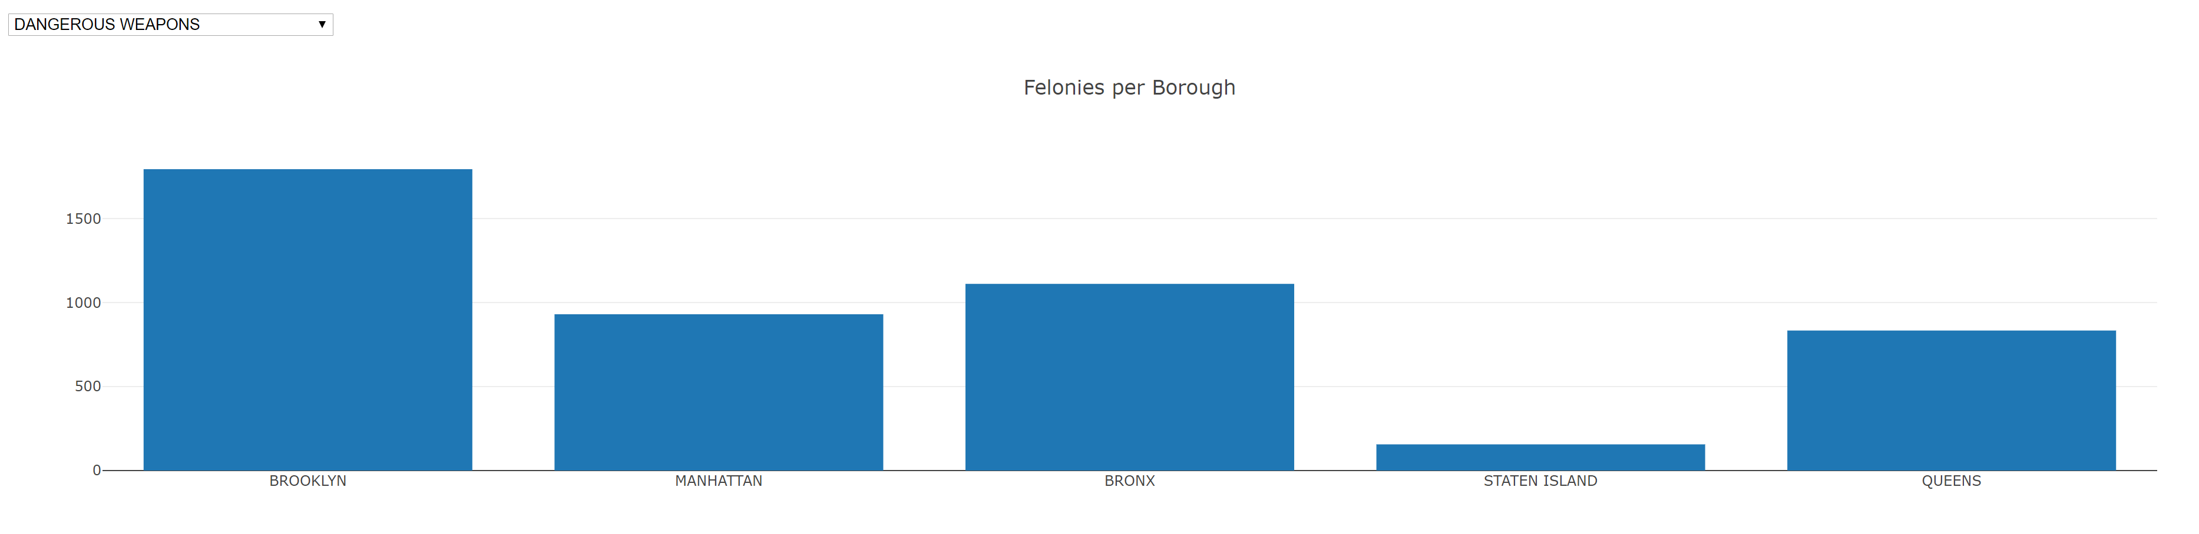
Visualizations
Felonies bar hcart with interactive drop down by felony type.

Slide 20

Questions?

